Slide 1

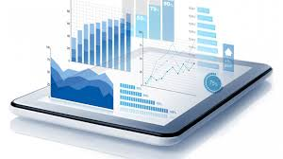
BlackTECH Academy Data analytics Capstone Project Cohort 4
Abumere Jean Akpamu
Jan 2023

Slide 2





Overview – Data Analysis Process
Cohort 4 Hotel, a hospitality company, engaged the services of a data analyst to develop a quarterly financial report for top executives. The report will provide insights into the company’s financial performance and help with critical business decisions that will ensure the company remains profitable and competitive.
Available data is an extract from a hotel systems, it consist five entity records (bookings, food orders, menu, requests and rooms) in comma separated value format.
The data analysis process is represented below
Data Collection
Analyze Data
2
3
4
5
Define Objective for Analysis
Data Cleaning
Make Decision

Slide 3
Issues and Recommendations
Observations
Recommendations
Data Entry Error
The dataset had some date errors; some records had 1996 instead of 2016. This can lead to false result during analysis
Data Entry Professional
Engage the services of a professional data entry personnel to help with the design of an effective data collection system. Ensuring proper naming standards and convention
Attribute Naming Inconsistency
Using two letter words without an underscore and not adopting a unique table identifier
Joining the tables will be pose a difficult problem if not corrected.
SQL Server may not recognize name format
Investment In Database
The management of Cohort 4 Hotel to consider investment in implementing a robust database to help manage the quality of generated business data
Adopting A Reporting Solution
The management of Cohort 4 Hotel to consider implementing a periodic reporting solutions like Power BI, Tableau, Spotfire etc.
Duplicates Data
Some attributes had duplicate date which can be clumsy during transformation process

Slide 4
Issues and Recommendations Cont’d

Slide 5
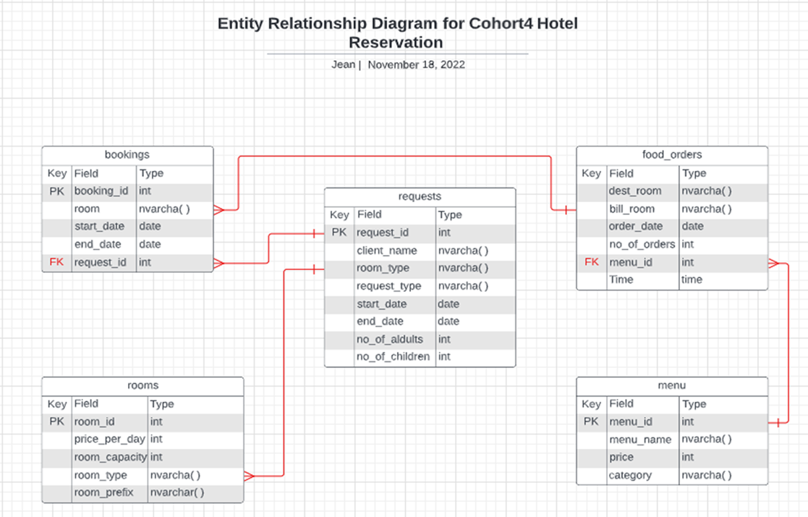
Entity Relationship Diagram and Azure Data Studio (SQL Server)
Imported the tables into Azure Data Studio (SQL Server)
Carried out tables joining in the SQL database
Connected the SQL database to Power BI for visualization
Imported SQL query result to Power BI, create visualizations to draw data insights from and to answer relevant business questions

Slide 6
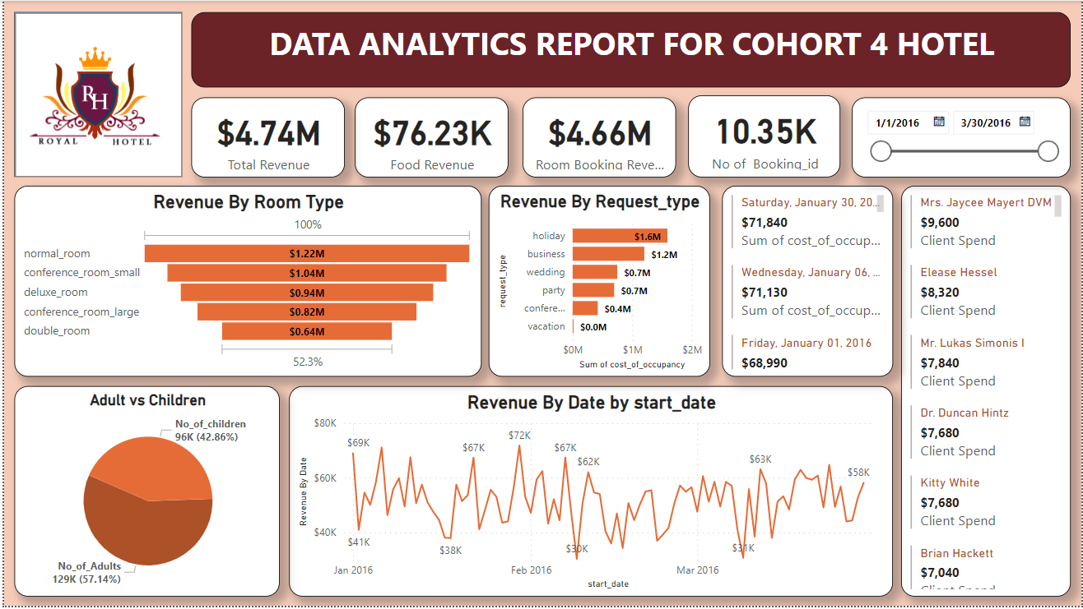
Visualization – Hotel Reservation
Analysis shows normal_room was the commonly requested room type by clients on holidays and business and this accounted for 26% of total Room Booking revenue. Offering a discount on other roomy type can improve revenue . Acquiring a second location with more normal_room will be profitable

Slide 7
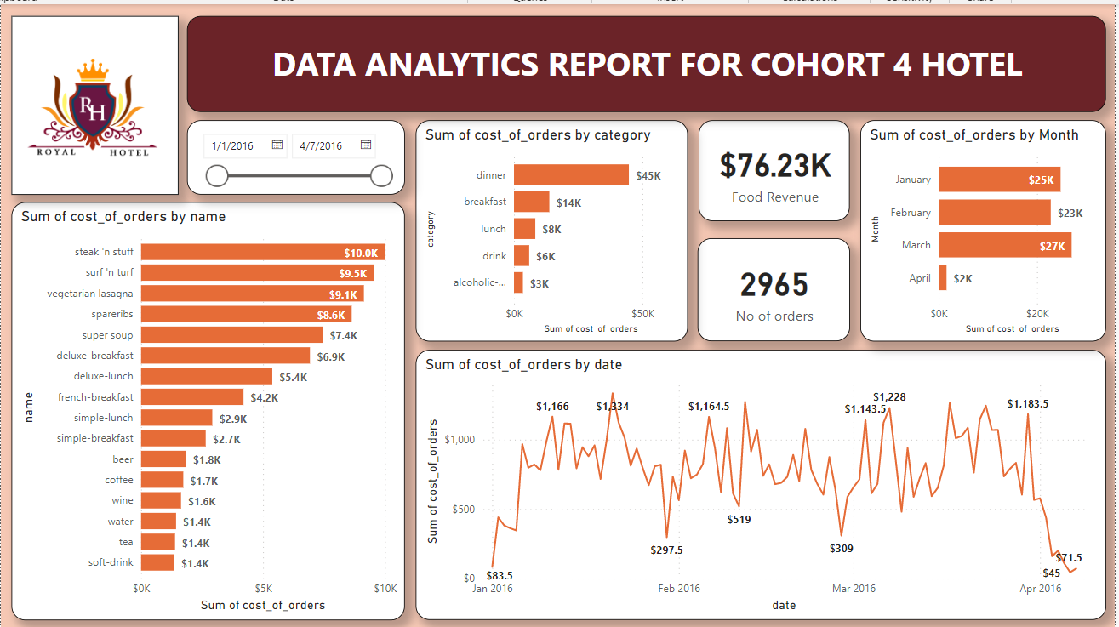
Visualization – Restaurant
Analysis revealed dinner was a popular order category with the top three menus of steak‘n’stuff, surf‘n’turf, and vegetable lasagna. Steak’n’stuff accounted for 13% of total food revenue. Offering a combination of meal and soft drink bundle will help to boost sales of soft drinks

Slide 8





Overview and Machine Learning
The Analytics team has been tasked to help the Collections team in the borrowers to predict whether the loan rolled or not rolled and how accurate the prediction is.
The figure describes the steps involved with the task
Data
Collection
Data
Pre-Processing
Model
Selection
Model
Training
Model
Evaluation
Train the model using selected algorithm
Predict /Testing the model on test data
Understand business needs and collecting relevant data
Understand data correlation, data cleaning and splitting
Choosing the right Model for training

Slide 9
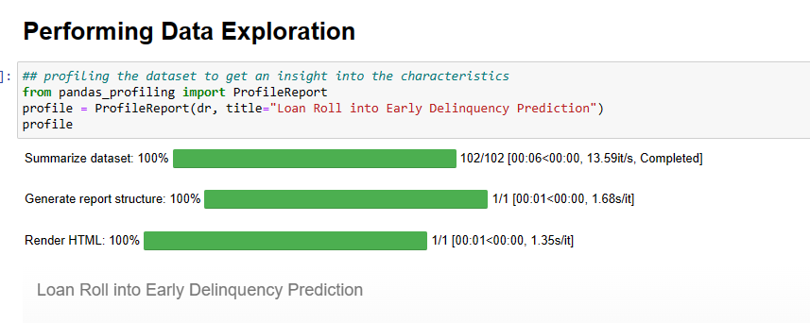
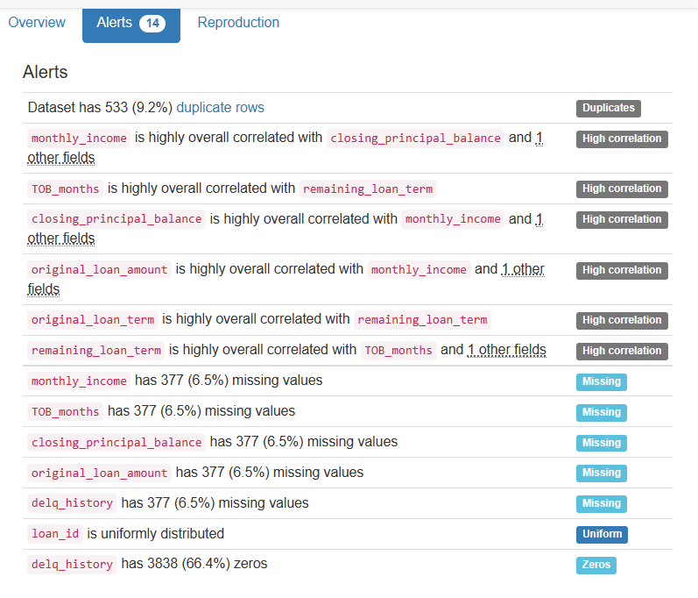
Machine Learning

Slide 10
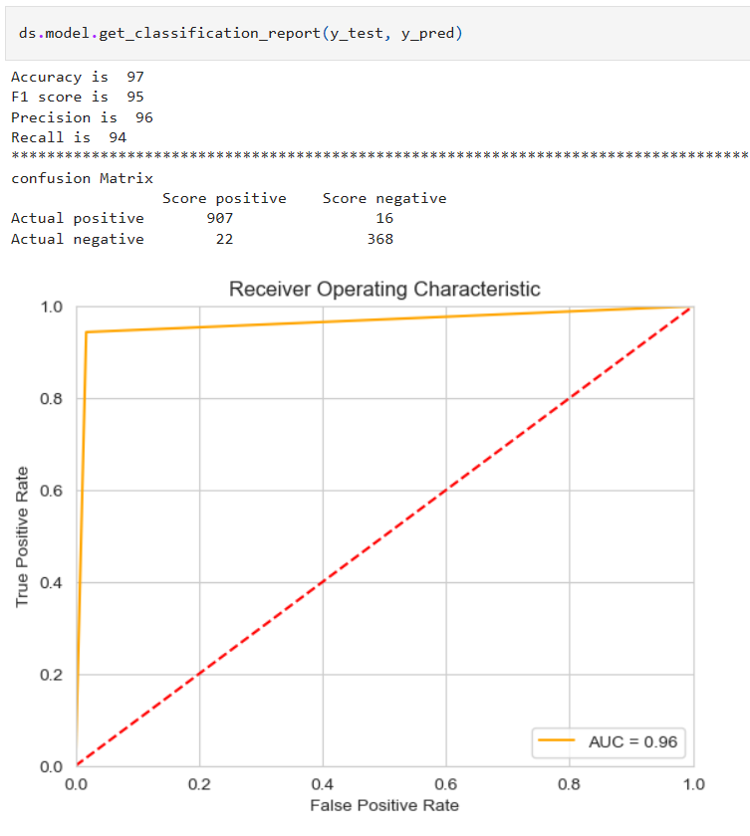
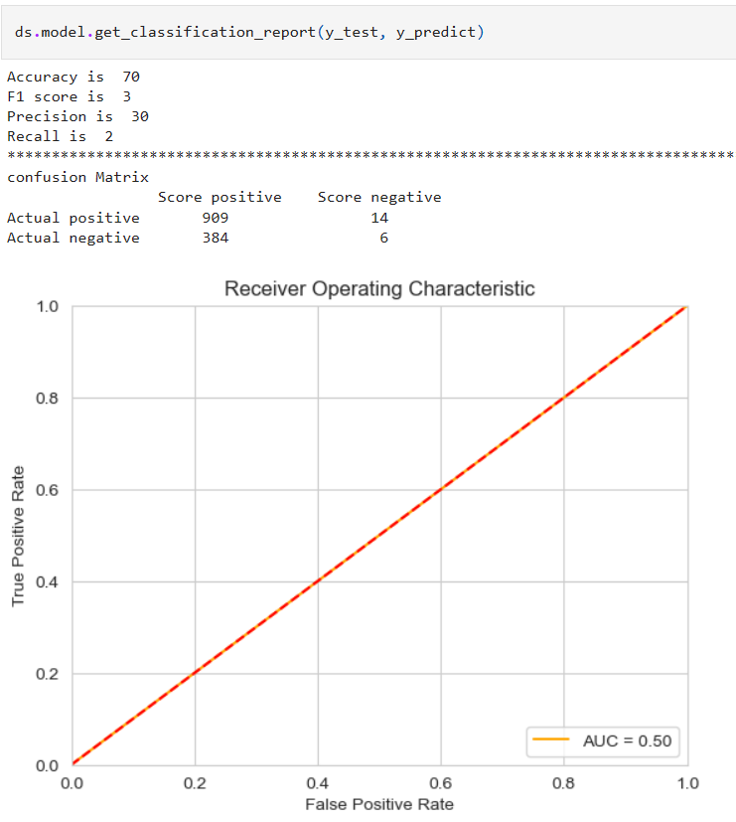
Prediction
RandomForestClassifier
LogisticRegression

Slide 11
Summary
The machine learning prediction was performed using the Random Forest Classifier model and compared with the Logistic Regression.
The Random Forest Classifier correctly predicted the loan will get rolled with a 97% accuracy while the Logistic Regression model predicted with a 70% accuracy
The Random Forest Classifier proved to be a better predictor than Logistic Regression

Slide 12
THANK YOU
Abumere Jean Akpamu​
Ja.akpamu@gmail.com

